Slide 1
8th Grade CRCT 2013
Level 1 Concepts

Slide 2
Basic Skills

Slide 3
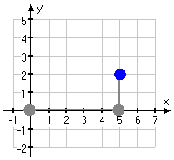
How Do You Plot Points?
Sing it! Over and up, over and up, x goes over and y goes up!
You must run before you jump!
You must crawl before you walk!
Plot (5,2) (Over 5, up 2)
Do not get this mixed up with slope, which is rise over run, where you go up and over!!!
Ask yourself, am I plotting a point, or am I finding the slope of a line?

Slide 4
Operations with Signed Numbers
Subtraction – Change the minus to a plus, and then change the sign of the next number (2 stroke method) NOW you have an ADDITION problem
Addition – Same signs add and keep, different signs subtract, keep the sign of the larger number, then you’ll be exact!
Multiplication AND Division
Think about shoes that match (that’s a good thing)
+
- -

Slide 5
Rewriting Decimals

Slide 6
Unit 1

Slide 7
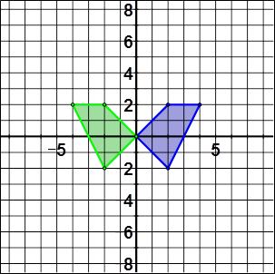
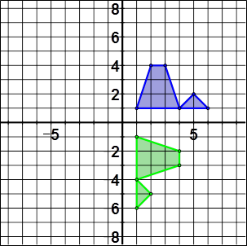
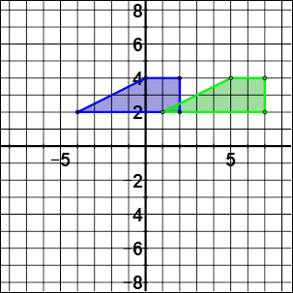
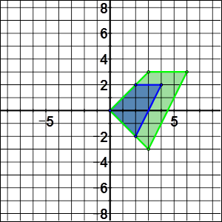
Transformations
Reflection
Rotation
Translation
Dilation
Trace Axis and figure
Flip Paper
Congruent
Trace Axis and figure
Rotate Figure
Congruent
Trace Axis and figure
Slide Figure
Congruent
Write down coordinates of vertices
Multiply each coordinate by scale factor
Plot new points
Similar

Slide 8
Transformations
A transformation is a change in the size or position of a figure.
A dilation will change the size of a figure unless
the scale factor is 1.
A translation will slide the figure horizontally
and/or vertically.
A rotation will turn the figure around the origin.
A reflection will flip the figure across an axis.

Slide 9
Transformations - Dilations

Slide 10
Transformations
Transformation | Coordinate Mapping
Translation | (x, y) → (x + a, y + b) translates left or right a units and up or down b units
Reflection | (x, y) → (−x, y) reflects across the y-axis (x, y) → (x, −y) reflects across the x-axis “When you reflect across the x, the x stays the same, when you reflect across the y, the y stays the same”
Rotation | (x, y) → (−x, −y) rotates 180° around origin (x, y) → (y, −x) rotates 90° clockwise around origin (x, y) → (−y, x) rotates 90° counterclockwise around origin
Dilation | (x, y) → (kx, ky) enlarges or shrinks by a scale factor k

Slide 11
Parallel Lines

Slide 12
Angles
Vertical– across from each other and congruent X
Supplementary - Straight line - adds up to 180° ________
Complementary – Corner – adds up to 90°

Slide 13
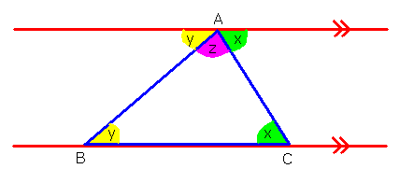
Triangle Angle Sum
∠x + ∠y + ∠z = 180°

Slide 14
Unit 2

Slide 15
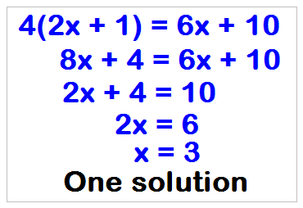
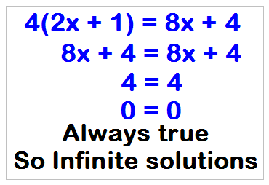
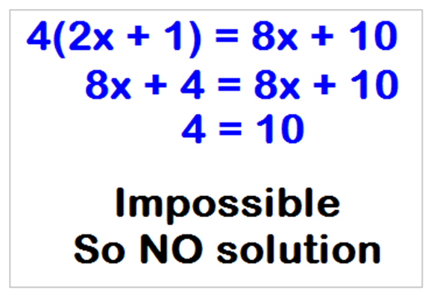
Solving Equations
Notice that 8x is on one side, and 6x is on the other
Notice that 8x is on both sides

Slide 16
Exponent Rules Song
When you multiply like bases, you add the exponents and the base stays the same
When you divide like bases, you subtract the exponents and the base stays the same.
Power to a power, multiply the powers and the base stays the same
Zero exponent, the answer is 1 and the base goes away
Negative Exponent, send it to the bottom, now you have a fraction and the base stays the same!

Slide 17
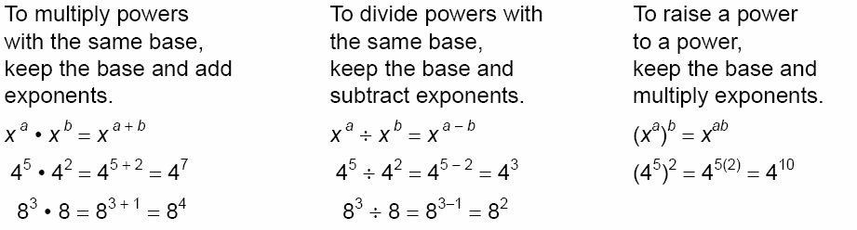
Exponent Rules

Slide 18
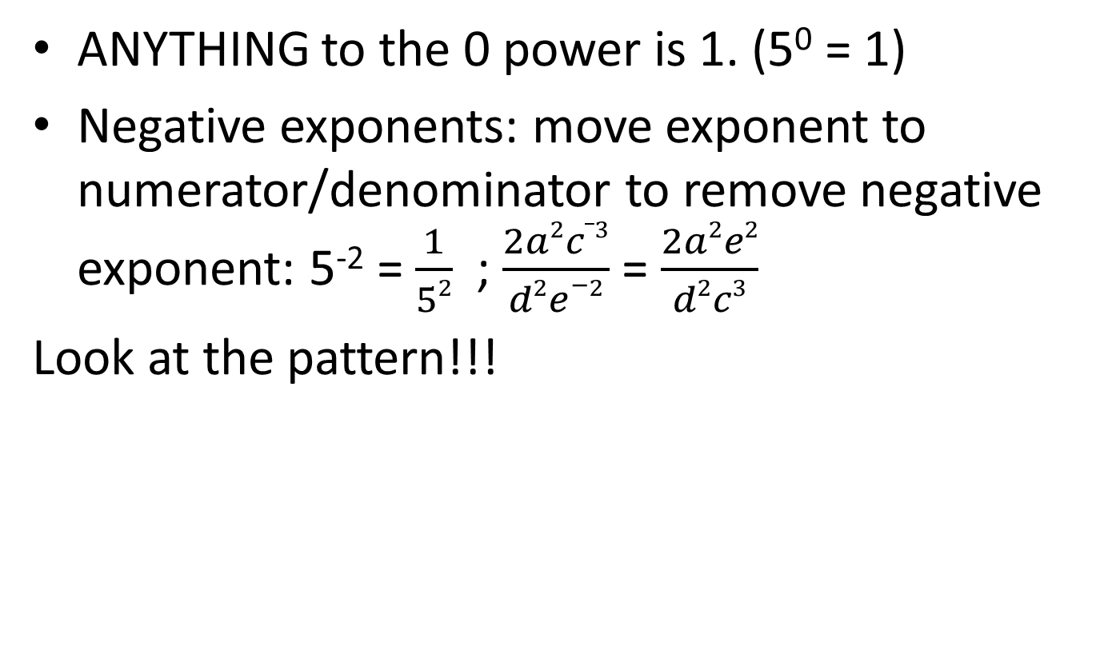
Exponent Computation
ANYTHING to the 0 power is 1. (5⁰ = 1)
Negative exponents: move exponent to numerator/denominator to remove negative exponent: 5⁻² = $\frac{1}{52}$ ; $\frac{2a2c_3}{d2e−2}$ = $\frac{2a2e2}{d2c3}$
Look at the pattern!!!

Slide 19
Scientific Notation
5.23 x 10⁵ = 523,000
Always one digit 1-9 and then a decimal point followed by x 10 to a power.
  5.23 x 10⁵ is in Scientific Notation
  52.3 x 10⁵ is NOT in Scientific Notation
  0.523 x 10⁵ is NOT in Scientific Notation
From Scientific Notation to Standard notation
1) Look at exponent
Put your pencil on the decimal point
Move that # of places
Add zeros if needed.
Negative Exponent – move left
Positive Exponent – move right

Slide 20
Scientific Notation
What is 523,000 in scientific notation? 5.23 x 10⁵
From Standard to Scientific notation (harder) Move decimal until you have a number that is between 1 and 10. If you don’t see a decimal, it is at the end of the number. Count the # of places you moved. If the original number was small, the sign will be negative.

Slide 21
Square Roots
Every positive number has 2 square roots; one is positive and one is negative
The square root of 0 is 0.
What are the square roots of 36?
6 and -6 (because -6 times -6 is 36)

Slide 22
Radicals
Perfect squares: 1, 4, 9, 16, 25, 36, 49, 64, 81, 100, 121, 144, …
is the radical sign. Asks what # times itself = radicand (# inside).
For squares…. Side length =
To approximate square root: find the 2 perfect squares that are smaller and larger than the # you have. Your answer is between those #s.

Slide 23
Rational/ Irrational Numbers
Rational numbers can be written as a fraction
Rational
Irrational
All fractions positive and negative (unless part of the fraction is irrational)
All mixed number and improper fractions positive and negative
Repeating decimals
Terminating decimals
The square root of perfect squares
Pi
Square root of 2
Square root of all positive numbers that are not perfect squares
Decimals that don’t repeat (No line over top of decimal) and don’t end. EX: 1.353634534635256…..

Slide 24
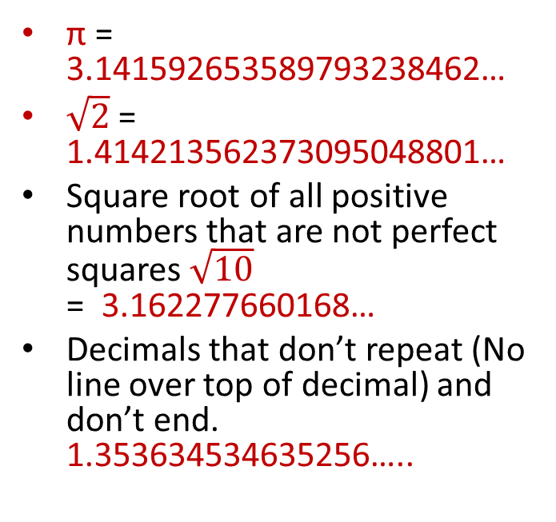
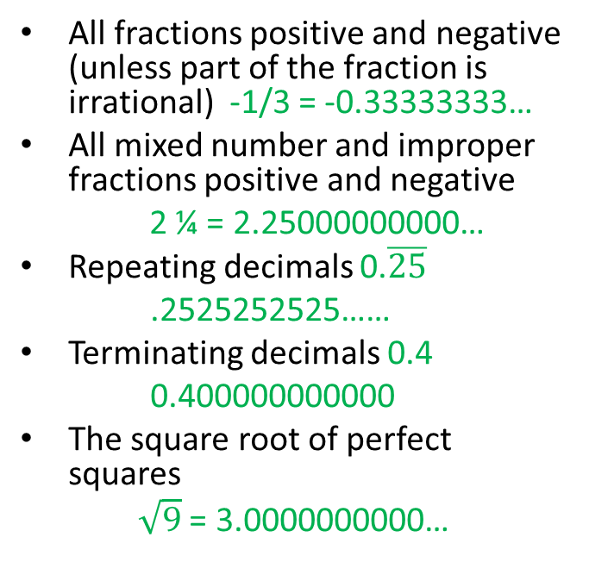
Rational/ Irrational Numbers
Another way to think about it:
ALL Rational numbers repeat eventually.
Rational
Irrational
All fractions positive and negative (unless part of the fraction is irrational) -1/3 = -0.33333333…
All mixed number and improper fractions positive and negative
2 ¼ = 2.25000000000…
Repeating decimals 0.$\overline{25}$
.2525252525……
Terminating decimals 0.4
0.400000000000
The square root of perfect squares
$\sqrt{9}$ = 3.0000000000…
π = 3.141592653589793238462…
$\sqrt{2}$ = 1.414213562373095048801…
Square root of all positive numbers that are not perfect squares $\sqrt{10}$ = 3.162277660168…
Decimals that don’t repeat (No line over top of decimal) and don’t end. 1.353634534635256…..

Slide 25
Unit 3

Slide 26
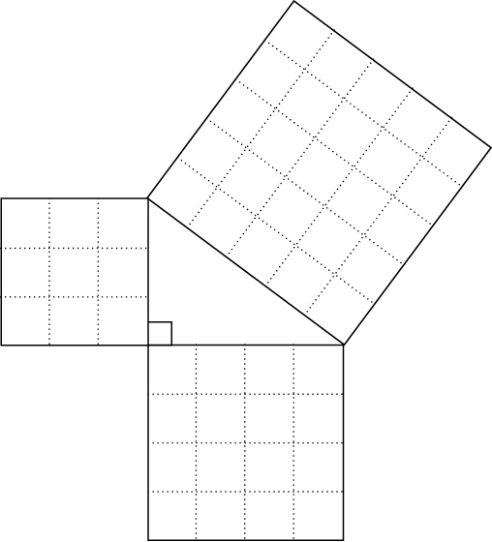
Pythagorean Theorem
In a right triangle,
the sum of the areas of the squares on the legs is equal to the area of the square on the hypotenuse.
3² + 4² = 5²
9 + 16 = 25

Slide 27
Pythagorean Theorem
a² + b² = c²
Key words: diagonals; right triangle; area
In word problems, reference to trees, buildings, etc. (make right angles from the ground) are hints to use Pythagorean Theorem.
hypotenuse
leg
leg

Slide 28
Pythagorean Theorem
Triples – Memorize and look for them in problems!!!!
3,4,5 and 5,12,13
If you memorize these 2 triples, you will also know the multiples are also right triangles.
6,8,10 10,24,25
9,12,15 15,36,39
12,16,20
15,20,25

Slide 29
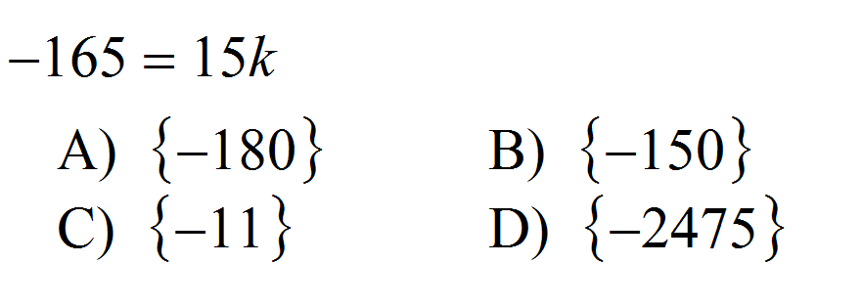
Solving Equations (Multiple Choice)
If you have a multiple choice problem, PLUG in values to see which one is correct.
Question:
Which value of k
is a solution to the
equation?
Look at the problem. 15k means “15 times k”. 15 times some number equals -165. Now look at your answer choices. You should notice that A,B, and D don’t make sense because the number are too big. Let’s see if -11 is the correct answer:
-165 = 15(-11)
-165 = -165 This is a true statement, so -11 is correct.

Slide 30
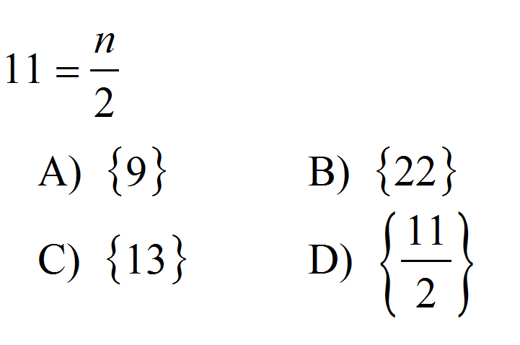
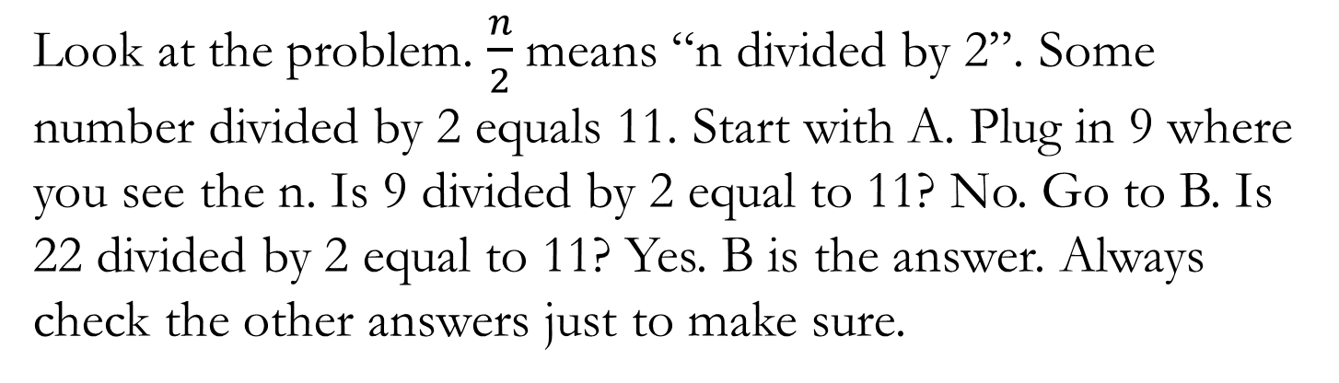
Solving Equations (Multiple Choice)
If you have a multiple choice problem, PLUG in values to see which one is correct.
Question:
Which value of n
makes the statement true?
Look at the problem. $\frac{n}{2}$means “n divided by 2”. Some number divided by 2 equals 11. Start with A. Plug in 9 where you see the n. Is 9 divided by 2 equal to 11? No. Go to B. Is 22 divided by 2 equal to 11? Yes. B is the answer. Always check the other answers just to make sure.

Slide 31
Unit 4

Slide 32
Functions
A relation is a set of ordered pairs.
{(1, 2), (3, 4), (5, 6)}
The domain of a relation is the set of all
first components of the ordered pairs.
{1, 3, 5}
The range of a relation is the set of all
second components of the ordered pairs.
{2, 4, 6}

Slide 33
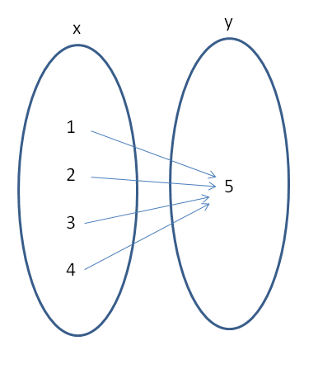
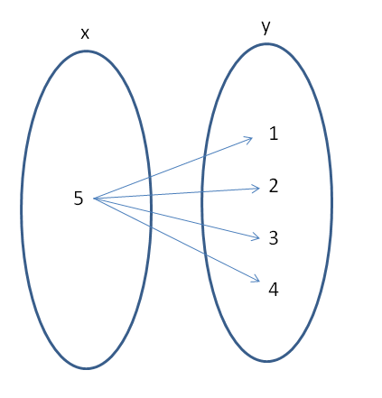
Functions – One output for each input
Think about a drink machine!
Function
Not a Function

Slide 34
Functions – One output for each input
Look at the x value (first number of each pair) If it repeats, it is Not a function!
A-{(1,2), (3,3), (4,5) (5,6)} Function
B-{(3,1), (2,1), (1,2), (3,2)}Not a function
C-{(4,1), (5,1), (6,1), (7,1)}Function
D-{(0,0), (1,1), (2,2), (3,3)}Function

Slide 35
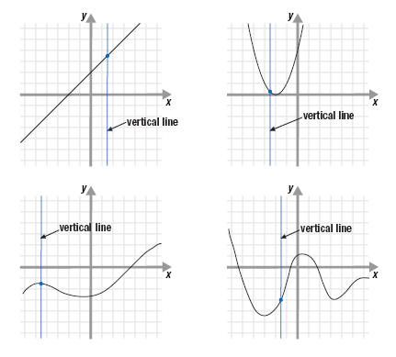
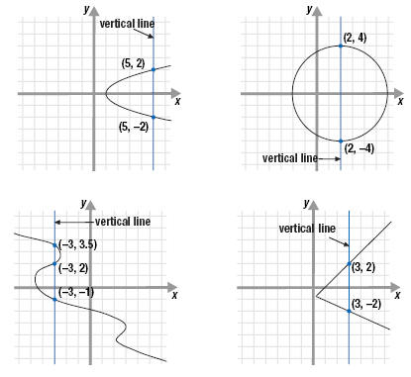
Functions – One output for each input
Think about a drink machine!
Function
Not a Function

Slide 36
Unit 5

Slide 37
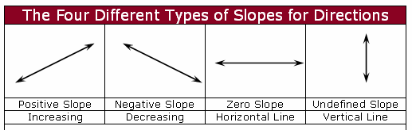
Slope
Do the Robot Dance
(Start with your left hand)

Slide 38
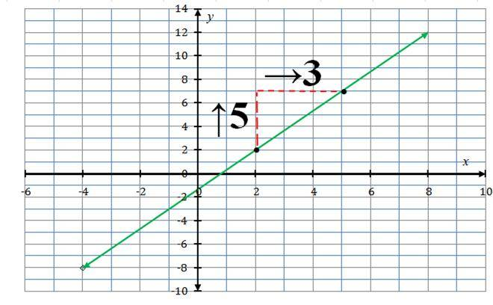
Finding slope of a line
Rise over Run
Pick 2 points
Make a right triangle
Start with left point, Move to the right point.
Up and to the right = positive slope
Down and to the right = negative slope
Rise = 5
Run 3

Slide 39
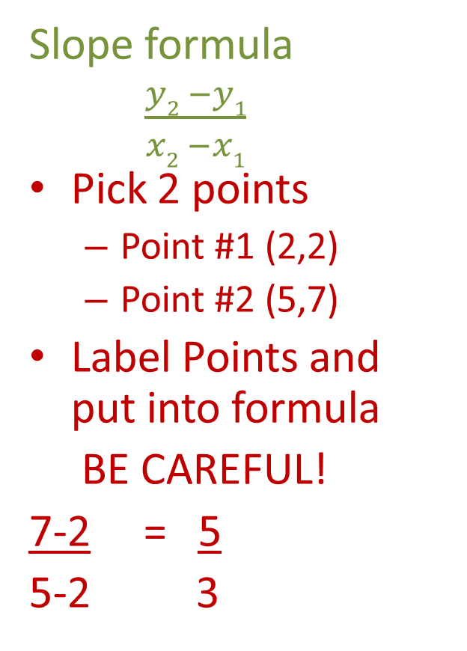
Finding slope of a line
Slope formula
$\frac{y2 −y1}{x2 −x1}$
Pick 2 points
  Point #1 (2,2)
  Point #2 (5,7)
Label Points and put into formula
BE CAREFUL!
7-2 = 5
5-2 3
Rise = 5
Run 3

Slide 40
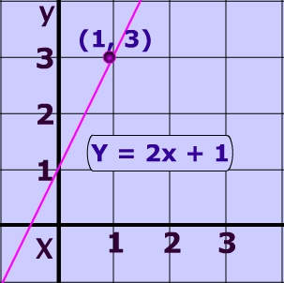
Writing the equation of a line
Look at y-intercept first.
Look at the slope
  Is it positive or negative?
  Rise over run

Slide 41
Finding slope and y-intercept from equation in slope-intercept form
y = mx + b
y = 2x – 4
1) What is the slope? 2
2) What is the y-intercept? -4
(Remember Slopem?)

Slide 42
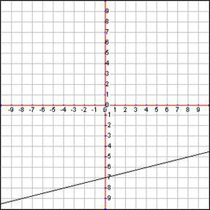
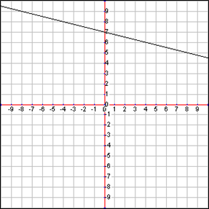
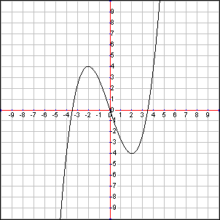
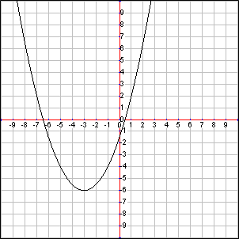
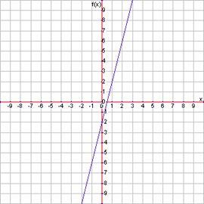
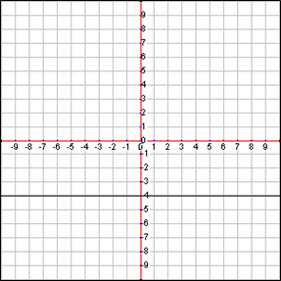
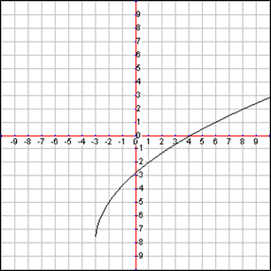
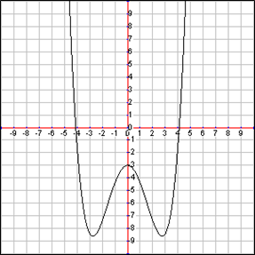
Linear vs. Non-Linear Graphs
Linear Functions (line)
Non-linear Functions (curved)

Slide 43

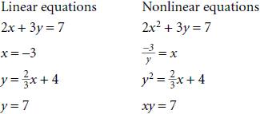
Linear vs. Nonlinear equations

Slide 44
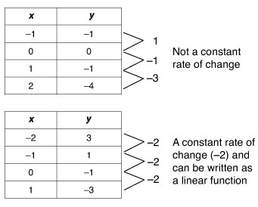
Linear vs. Nonlinear Tables

Slide 45
Linear vs. Nonlinear Descriptions
Perimeter is linear
Area is non-linear
Volume is non-linear

Slide 46
Unit 6

Slide 47
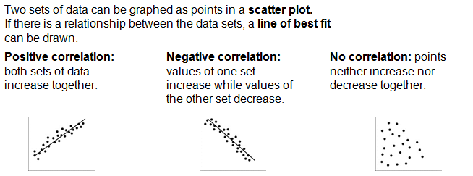
Scatter Plots

Slide 48
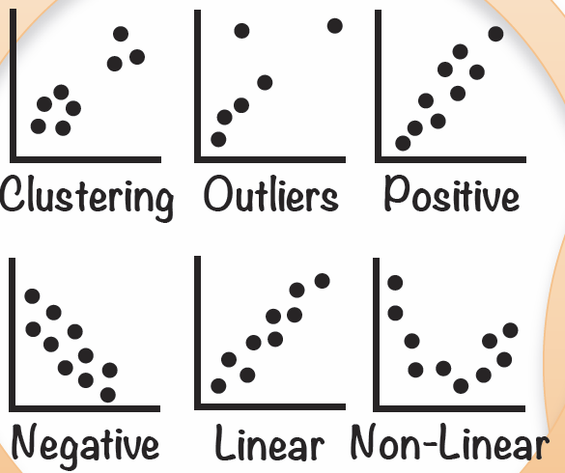
Scatter Plots

Slide 49
Unit 7

Slide 50
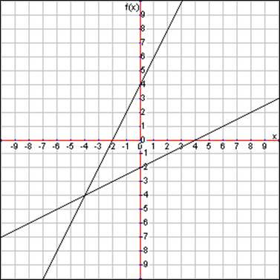
Systems of Equations
The solution to the system is the point where the lines intersect
(-4,-4) is the
solution
to the system

Slide 51
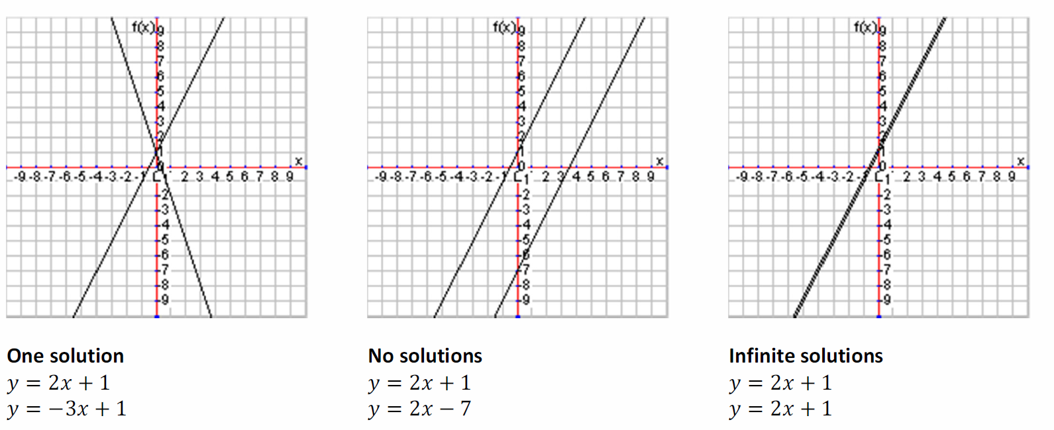
Systems of Equations
The solution to the system is the point where the lines intersect
(0,1)

Slide 52
Level 2 Concepts (If proficient in level 1 concepts)

Slide 53
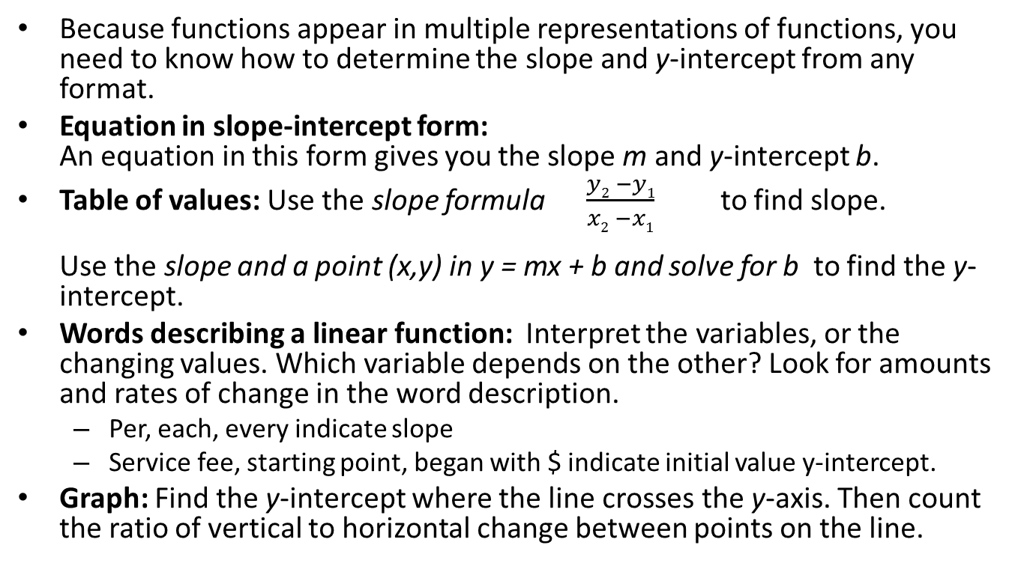
Writing Linear Equations
Because functions appear in multiple representations of functions, you need to know how to determine the slope and y-intercept from any format.
Equation in slope-intercept form:
An equation in this form gives you the slope m and y-intercept b.
Table of values: Use the slope formula $\frac{y2 −y1}{x2 −x1}$ to find slope.
Use the slope and a point (x,y) in y = mx + b and solve for b to find the y-intercept.
Words describing a linear function: Interpret the variables, or the changing values. Which variable depends on the other? Look for amounts and rates of change in the word description.
  Per, each, every indicate slope
  Service fee, starting point, began with $ indicate initial value y-intercept.
Graph: Find the y-intercept where the line crosses the y-axis. Then count the ratio of vertical to horizontal change between points on the line.

Slide 54
Systems of Equations
Graph & Check: graph lines using slop-intercept rules; point of intersection is solution.
Substitution: get one variable by itself; substitute into other equation to get 2nd variable isolated; determine ordered pair
CHECK! Plug in (x,y) to see if ordered pair is a solution
ORDERED PAIR MUST WORK IN ALL EQUATIONS!

Slide 55
Inequalities (Transition Standard)
< less than; > greater than
Solve inequalities just like equations
Remember to reverse inequality when MULT/DIV by a NEGATIVE.
Open dot for less/ greater than
Closed dot for less/greater OR equal to

Slide 56
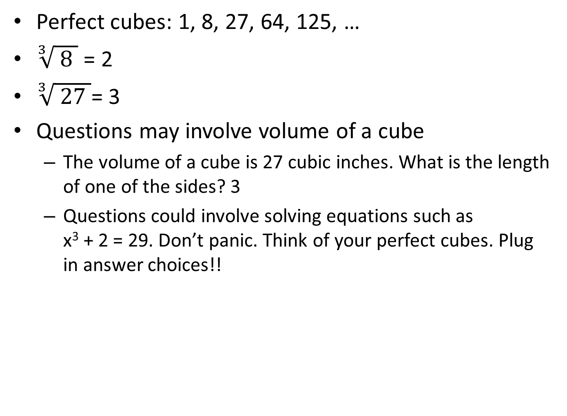
Cubed Roots
Perfect cubes: 1, 8, 27, 64, 125, …
$\sqrt[3]{ 8 }$ = 2
$\sqrt[3]{ 27 }$= 3
Questions may involve volume of a cube
  The volume of a cube is 27 cubic inches. What is the length of one of the sides? 3
  Questions could involve solving equations such as x³ + 2 = 29. Don’t panic. Think of your perfect cubes. Plug in answer choices!!

Slide 57
Line of Best Fit
Choose the line that “fits” the best.
If there is no line, draw one.
If you are asked to find the equation of the line of best fit, 1st draw the line, then look at the approximate y-intercept, and slope. Put it into slope-intercept form (y=mx +b)
If you are asked to make a prediction, 1st draw the line of best fit, then match up the x,y values with the question.

Slide 58
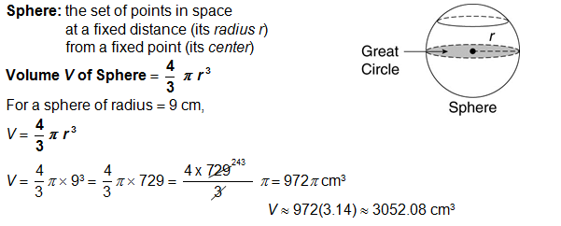

Slide 59
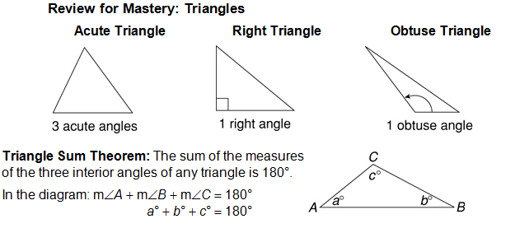
Triangles

Slide 60
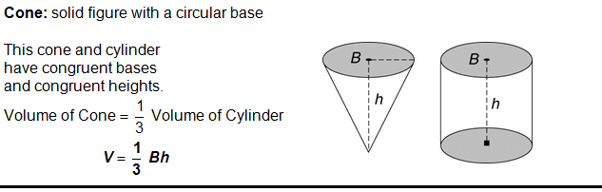
Volume of Cone

Slide 61
Pythagorean Theorem
More Triples
(3,4,5) | (5,12,13) | (7,24,25) | (8,15,17) | (9,40,41)
(11,60,61) | (12,35,37) | (13,84,85) | (15,112,113) | (16,63,65)
(17,144,145) | (19,180,181) | (20,21,29) | (20,99,101) | (21,220,221)
(23,264,265) | (24,143,145) | (25,312,313) | (27,364,365) | (28,45,53)
(28,195,197) | (29,420,421) | (31,480,481) | (32,255,257) | (33,56,65)
(33,544,545) | (35,612,613) | (36,77,85) | (36,323,325) | (37,684,685)

Slide 62
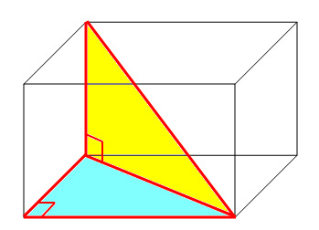

Pythagorean Theorem – 3D
$$d^{2}= \sqrt{ a^{2 }+b^{2}+c^{2} }$$
One Pythagorean quadruple is {6, 10, 15, 19}.
Others are: {2, 3, 6, 7}; {1, 2, 2, 3}; {3, 4, 12, 13}
http://www.education.vic.gov.au/school/teachers/teachingresources/discipline/maths/continuum/Pages/pythag575.aspx

Slide 63
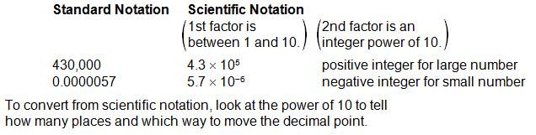

Slide 64
Scientific Notation Computation

Slide 65
Equations
Use inverses to move terms across the = sign.
Check for distributive property 1st.
Move variables to one side 2nd.
Undo add/sub from the side where the variable is 3rd.
Undo mult/div from the side where the variable is 4th.
Check your solution by substituting into original equation.

Slide 66
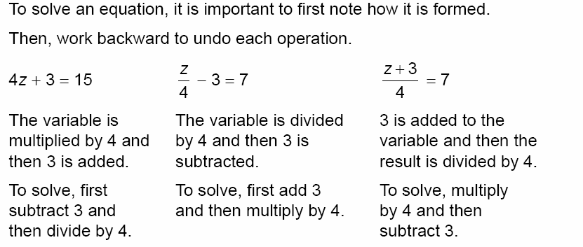
Solving Equations

Slide 67
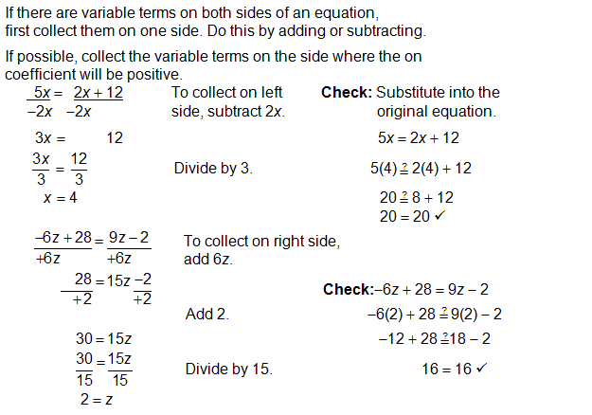
Solving Equations

Slide 68
Functions
Relations are a correspondence between varying quantities.
A SPECIAL relation is a FUNCTION. For each input (x), there is only ONE output (y).
Always look at the INPUT; if it repeats, it is NOT a function.
Use function tables & substitution to create ordered pairs for graphing
The rule is whatever you do to x to end up with y.
Ordered pairs are solutions to the equation or function.
Graphs will be LINEAR if the variables have an exponent of 1.

Slide 69
Functions

Slide 70
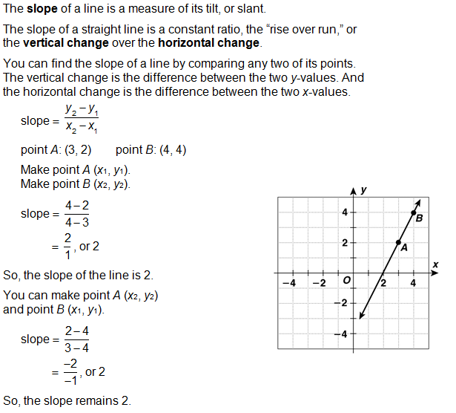
Slope

Slide 71

Graphing Equations
Slope= $\frac{y2 −y1}{x2 −x1}$
Get equations into slope-intercept form to graph!
Slope-intercept y = mx + b
m = slope; b = y-intercept (0, b)
Graph y-intercept 1st
Use slope to find 2nd point
Connect dots to form line
(b is where you “begin” and m is how you “move”

Slide 72

Slopes and Intercepts

Slide 73

Writing Equations
Standard form: Ax + By = C
x & y on same side; No decimals or fractions
A, B, are the numbers in front of x and y (coefficients)
Slope = - $\frac{A}{B}$
y-intercept (plug in 0 for x)
2x + 3y = 6
  Slope is - $\frac{2}{3}$
  y-intercept is 2(0) + 3y = 6
          3y = 6
          y = 2 ← y-intercept is 2 (0,2)
  y-intercept form is y = - $\frac{2}{3}$x + 2

Slide 74
Parallel & Perpendicular
Parallel means SAME slope (m) and DIFFERENT y-intercept (b)
Perpendicular means NEGATIVE RECIPROCAL slope. (ex: ½ = -2)
If asked to find an equation parallel/perpendicular to given equation, find the slope of the original 1st.
Determine what the slope should be for the new line using above rules.

Slide 75
Probability (Transition Standard)
Sample space-- # possible outcomes
Outcomes: How many ways can you make a sandwich/outfit problem: MULT the number of choices together.
Probability of an event:
# of times event can occur
# of possible total events
Probabilities are fractions (between 0 and 1 inclusive)
May be in the form of a decimal or percentage
AND statements– multiply the probabilities
OR statements– add the probabilities

Slide 76

Congruent Figures
Congruence statement shows what angles are congruent to each other $∆$ABC $≅$ $∆$DEF means ∠A $≅$ ∠D, ∠B $≅$ ∠E, ∠C $≅$ ∠F.
If you are required to create a congruence statement, match up each angle one by one.

Slide 77

Similar Triangles
Similar Triangles have congruent angles, and the sides are proportional.$∆$ABC $\sim$ $∆$DEF means ∠A $≅$ ∠D, ∠B $≅$ ∠E, ∠C $≅$ ∠F.
  The order of the letters matches up.
  If 2 angles of a triangle are congruent, then the other angle must be congruent, and the triangles are similar.

Slide 78
Proportional Segments
Used with parallel lines/transversals
Also used with similar triangles
Set up a proportion
Cross multiply
Solve for x.

Slide 79

2-way tables

Slide 80

2-way tables

Slide 81

2-way tables

Slide 82

2-way tables

Slide 83

2-way tables

Slide 84

2-way tables

